Slide 1
Transaction Support using Compound Commands in Key-Value SSDs
Kim, S. H., Kim, J., Jeong, K., & Kim, J. S.
In 11th {USENIX} Workshop on Hot Topics in Storage and File Systems (HotStorage 19).
Presenter: 이광희
2021. 01. 05

Slide 2
Introduction
Motivation
Design
Format
User API
Evaluation
Conclusion

Slide 3
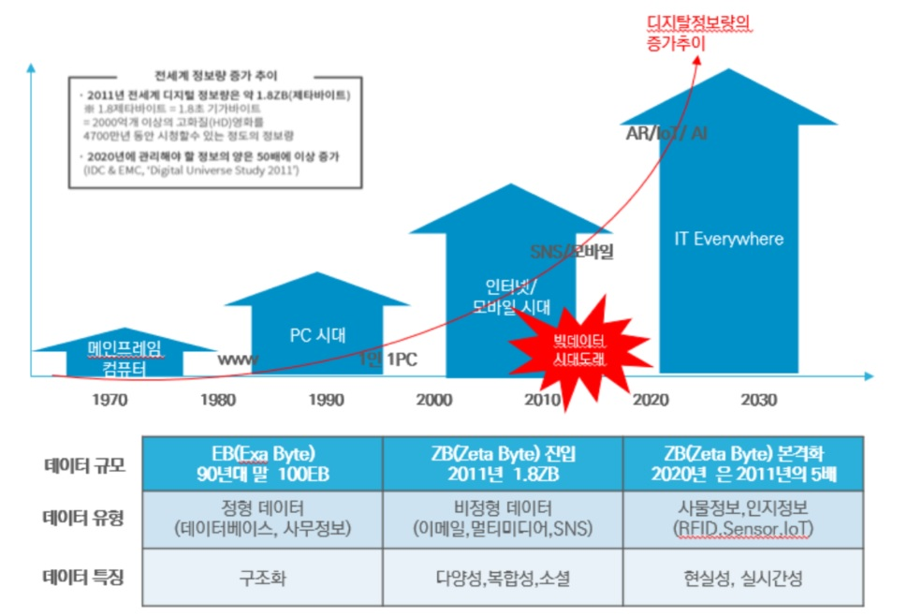


1. Introduction
Unstructured data
Key-Value Store

Slide 4
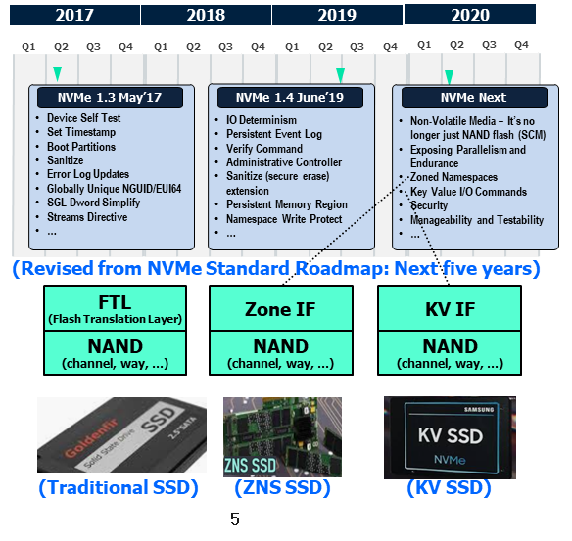
1. Introduction
Next-generation Storage
NVMe Standard Roadmap

Slide 5
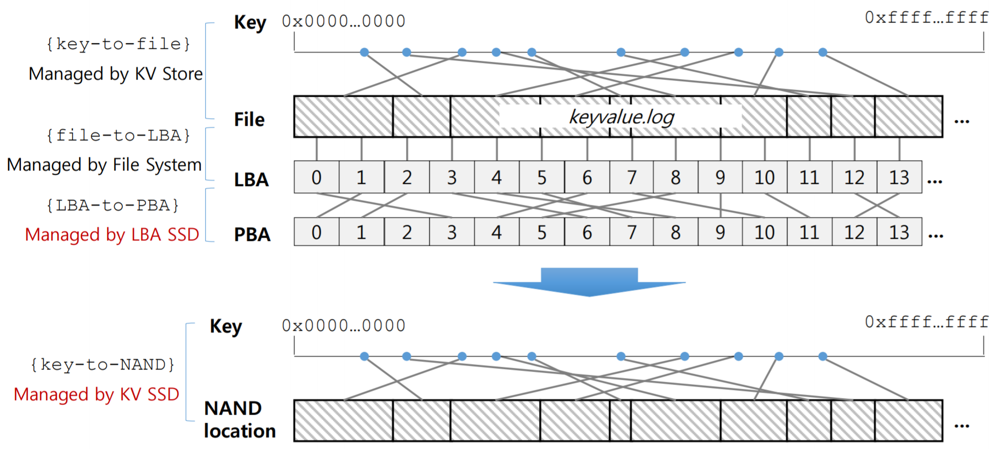
1. Introduction
Samsung KVSSD
TrSSD vs KVSSD
Resource: kvssd_seminar_2018_fw_introduction.pdf

Slide 6
2. Motivation
Small data size overhead

Slide 7
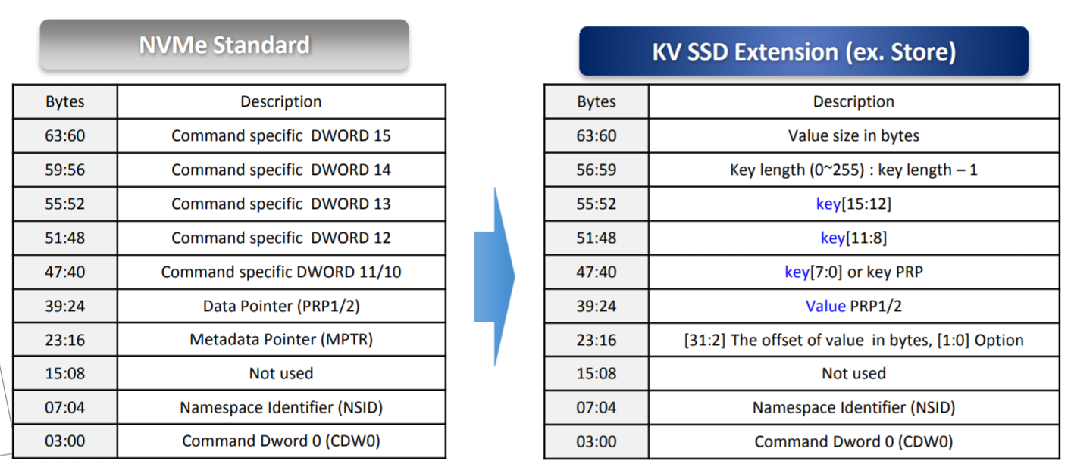
2. Motivation
Small data size overhead
Resource: kvssd_seminar_2018_fw_introduction.pdf

Slide 8
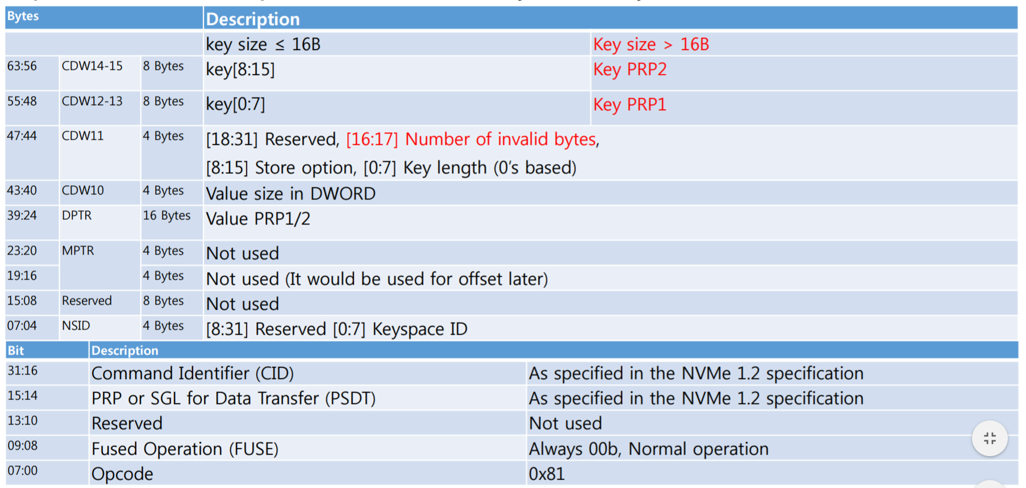
3. Design - Format
Inline key
Resource: kvssd_seminar_2018_fw_introduction.pdf

Slide 9
3. Design - Format
Inline key => Identification Number (ID)
Identification Number (16byte)
=> Transaction ID, Group ID
Resource: kvssd_seminar_2018_fw_introduction.pdf

Slide 10
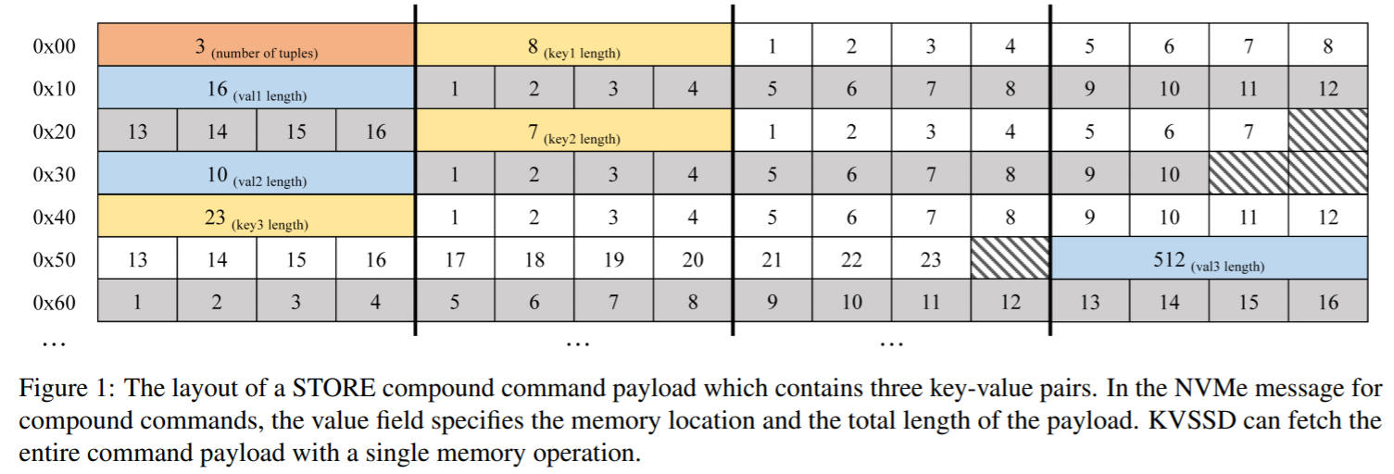
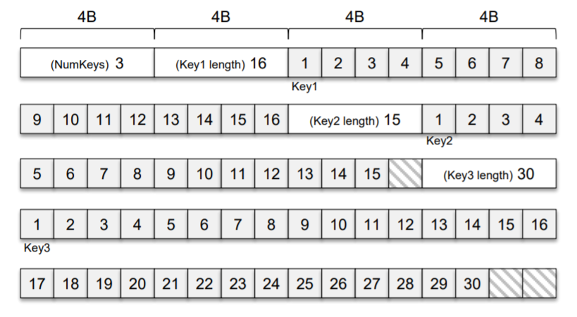
3. Design - Format
Compound Command Format
Resource: kvssd_seminar_2018_fw_introduction.pdf

Slide 11
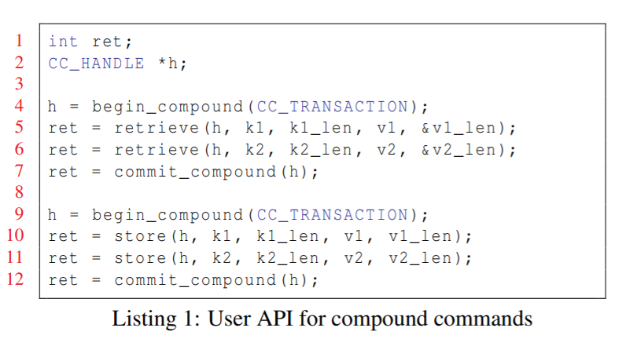
3. Design – User API
Compound Command User API
Future work: Amazon DynamoDB
Current work: Transaction operations of RocksDB

Slide 12
4. Evaluation
Time Key
TrSSD: Block-4KB
KVSSD: Key-16byte, Value-4KB
=> TrSSD: 13.49us / KVSSD: 46.14us = 32.65us(70.8%)
Time Value
KVCeph workload(key:32byte, value: 1024byte), 3 operation
KVSSD: Key-16byte, Value-3196byte
=> pair number(4) + (key length(4) + key(32) + value length(4) + value(1024)) * 3

Slide 13
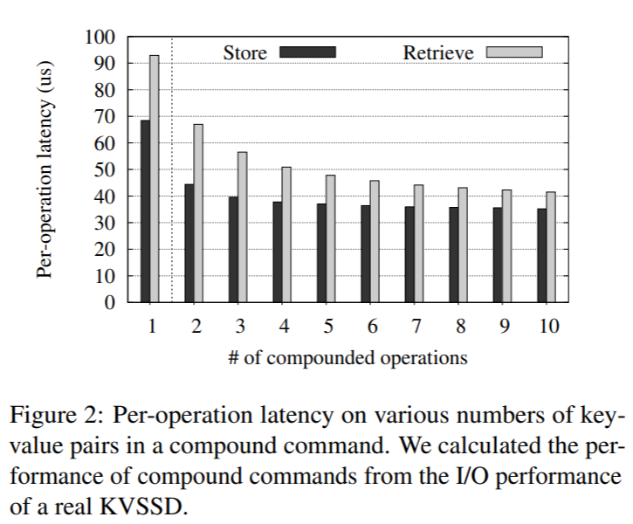
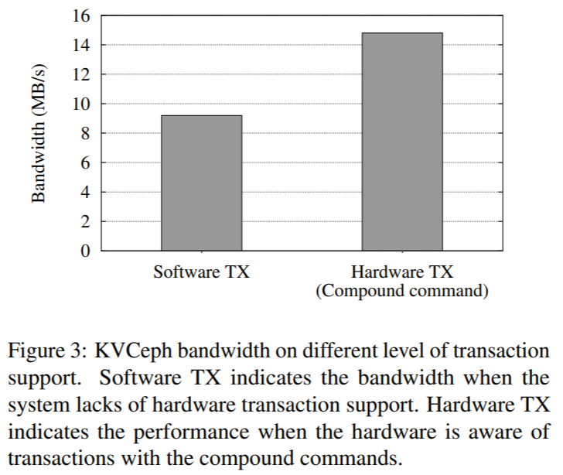
4. Evaluation
I/O performance: Estimate
KVCeph: WAL

Slide 14
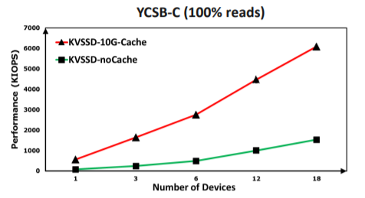
5. Conclusion
KVSSD - Compound Commands
Real KVSSD – Evaluation(Estimate)
Future work: Compound Commands => KVSSD Compound Commands
Resource: Towards Building a High-Performance, Scale-In Key-Value Storage System(Systor’19)

Slide 15
Thank You!
2021. 01. 05

